Slide 1

CS654: Digital Image Analysis
Lecture 37: Feature Representation and Matching
Slide adapted from: Kristen Grauman, Derek Hoiem, A. Efros

Slide 2
Feature Vectors
A feature vector is a method to represent an image or part of an image.
A feature vector is an n-dimensional vector that contains a set of values where each value represents a certain feature.
This vector can be used to classify an object, or provide us with condensed higher-level information regarding the image.

Slide 3
Distance & Similarity Measures
Feature vector is to present the object and will be used to classify it
To perform classification, need to compare two feature vectors
2 primary methods – difference between two or similarity
Two vectors that are closely related will have small difference and large similarity

Slide 4
Distance Measures
Difference can be measured by distance measure in n-dimensional feature space; the bigger the distance – the greater the difference
Several metric measurement
Euclidean distance
Range-normalized Euclidean distance
City block or absolute value metric
Maximum value

Slide 5
Distance Measures
Euclidean distance is the most common metric for measuring the distance between two vectors.
Given two vectors A and B, where:

Slide 6
Distance Measures
The Euclidean distance is given by:
This measure may be biased as a result of the varying range on different components of the vector.
One component may range 1 to 5, another component may range 1 to 5000.

Slide 7
Distance Measures
A difference of 5 is significant on the first component, but insignificant on the second component.
This problem can be rectified by using range-normalized Euclidean distance:
R_{i} is the range of the
ith component.

Slide 8
Distance Measures
Another distance measure, called the city block or absolute value metric, is defined as follows:
This metric is computationally faster than the Euclidean distance but gives similar result.

Slide 9
Distance Measures
The city block distance can also be range-normalized
It gives a range-normalized city block distance metric, with R_{i} defined as before:

Slide 10
Distance Measures
The final distance metric considered here is the maximum value metric defined by:
The normalized version:

Slide 11


Why extract features?
Motivation: panorama stitching
We have two images – how do we combine them?

Slide 12

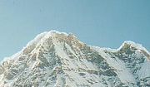
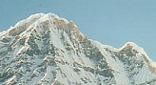
Local features: main components
Detection: Identify the interest points
Description: Extract vector feature descriptor surrounding each interest point.
Matching: Determine correspondence between descriptors in two views

Slide 13

Characteristics of good features
Repeatability
The same feature can be found in several images despite geometric and photometric transformations
Saliency
Each feature is distinctive
Compactness and efficiency
Many fewer features than image pixels
Locality
A feature occupies a relatively small area of the image

Slide 14
Goal: interest operator repeatability
We want to detect (at least some of) the same points in both images.
Yet we have to be able to run the detection procedure independently per image.
No chance to find true matches!
Notes:
14

Slide 15
Goal: descriptor distinctiveness
We want to be able to reliably determine which point goes with which.
Must provide some invariance to geometric and photometric differences between the two views.
?

Slide 16
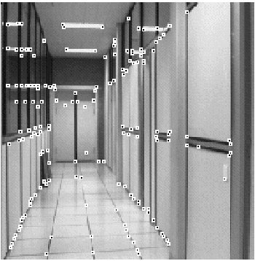
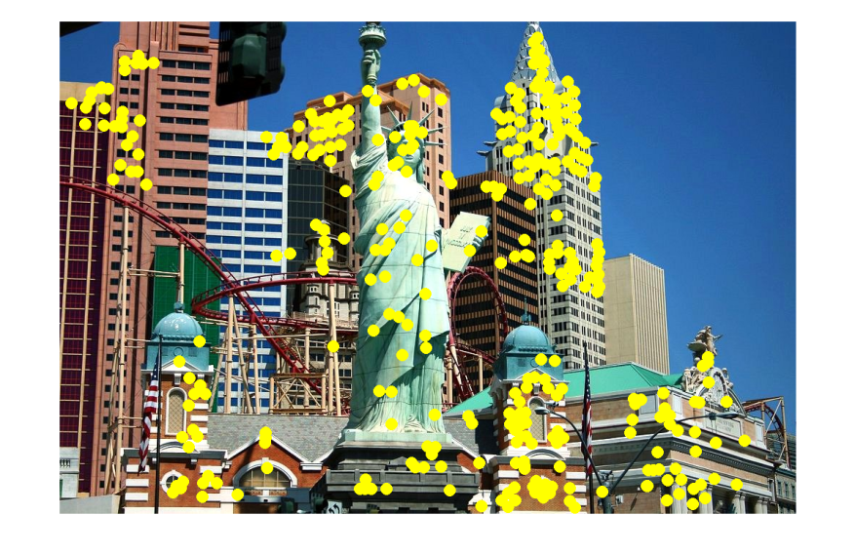
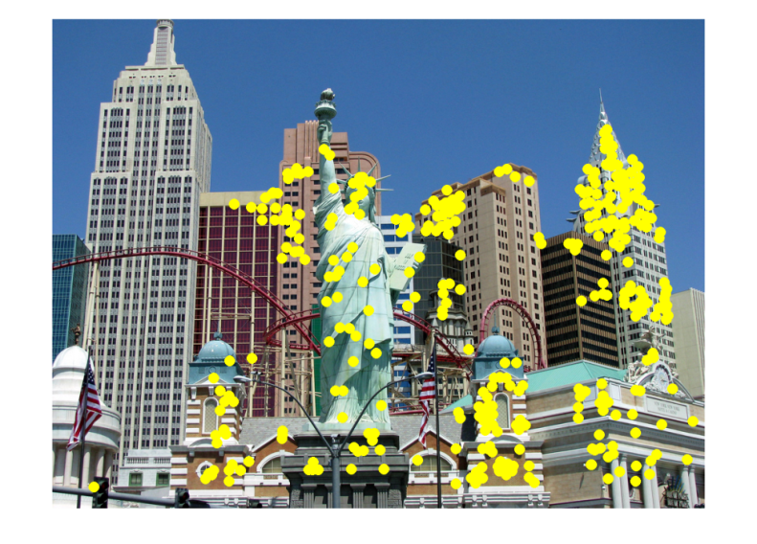
Applications
Feature points are used for:
Image alignment
3D reconstruction
Motion tracking
Robot navigation
Indexing and database retrieval
Object recognition

Slide 17
Local features: main components
Detection: Identify the interest points
Description:Extract vector feature descriptor surrounding each interest point.
Matching: Determine correspondence between descriptors in two views

Slide 18
Many Existing Detectors Available
Hessian & Harris [Beaudet ‘78], [Harris ‘88]
Laplacian, DoG [Lindeberg ‘98], [Lowe 1999]
Harris-/Hessian-Laplace [Mikolajczyk & Schmid ‘01]
Harris-/Hessian-Affine [Mikolajczyk & Schmid ‘04]
EBR and IBR [Tuytelaars & Van Gool ‘04]
MSER [Matas ‘02]
Salient Regions [Kadir & Brady ‘01]
Others…

Slide 19
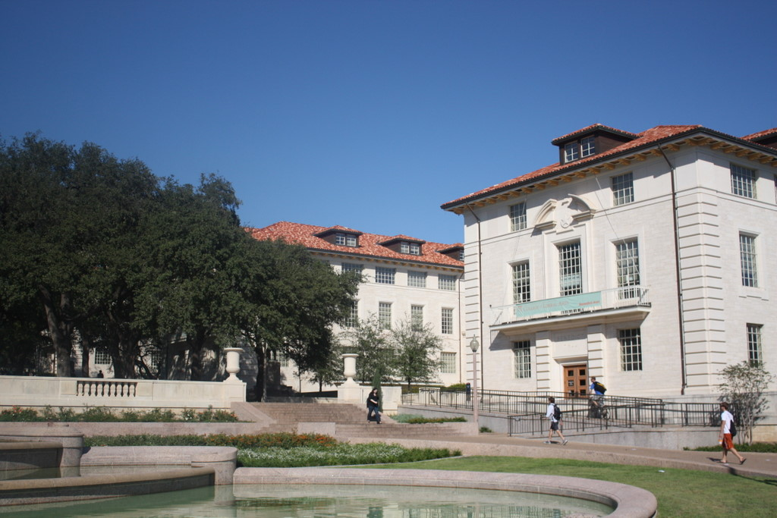
What points would you choose?

Slide 20

Corner Detection: Basic Idea
We should easily recognize the point by looking through a small window
Shifting a window in any direction should give a large change in intensity
“flat” region: no change in all directions
“edge”: no change along the edge direction
“corner”: significant change in all directions

Slide 21
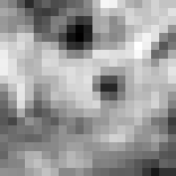

Corner Detection: Mathematics
Change in appearance of window w(x,y) for the shift [u,v]:
I(x, y)
E(u, v)
E(3,2)
w(x, y)

Slide 22
Corner Detection: Mathematics
Change in appearance of window w(x,y) for the shift [u,v]:
I(x, y)
E(u, v)
E(0,0)
w(x, y)

Slide 23
Corner Detection: Mathematics
Change in appearance of window w(x,y) for the shift [u,v]:
Window function
Shifted intensity
Intensity
Window function w(x,y) =
or
1 in window, 0 outside
Gaussian

Slide 24
Corner Detection: Mathematics
Change in appearance of window w(x,y) for the shift [u,v]:
We want to find out how this function behaves for small shifts
E(u, v)

Slide 25
Corner Detection: Mathematics
The quadratic approximation simplifies to
where M is a second moment matrix computed from image derivatives:
M

Slide 26
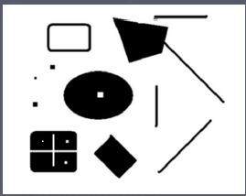
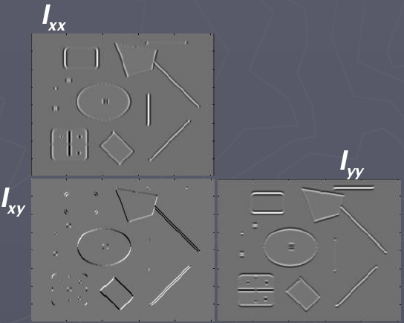
Corners as distinctive interest points
2 x 2 matrix of image derivatives (averaged in neighborhood of a point).
Notation:

Slide 27
Interpreting the second moment matrix
Consider a horizontal “slice” of E(u, v):
This is the equation of an ellipse.
Diagonalization of M:
The axis lengths of the ellipse are determined by the eigenvalues and the orientation is determined by R
direction of the fastest change
direction of the slowest change
(λ_{max})^{-1/2}
(λ_{min})^{-1/2}

Slide 28
Interpreting the eigenvalues
Classification of image points using eigenvalues of M:
λ₂
“Edge” λ₂ >> λ₁
“Corner” λ₁ and λ₂ are large, λ₁ ~ λ₂; E increases in all directions
λ₁ and λ₂ are small; E is almost constant in all directions
“Flat” region
“Edge” λ₁ >> λ₂
λ₁

Slide 29
Corner response function
“Edge” R < 0
α: constant (0.04 to 0.06)
“Corner” R > 0
|R| small
“Flat” region
“Edge” R < 0

Slide 30
Harris corner detector
Compute M matrix for each image window to get their cornerness scores.
Find points whose surrounding window gave large corner response (f> threshold)
Take the points of local maxima, i.e., perform non-maximum suppression
C.Harris and M.Stephens. “A Combined Corner and Edge Detector.” Proceedings of the 4th Alvey Vision Conference: pages 147—151, 1988.
Notes:
30

Slide 31
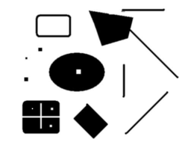
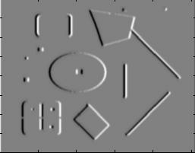
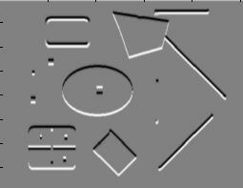
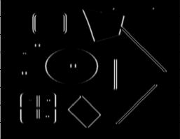
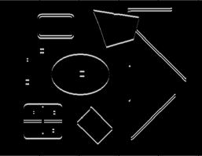
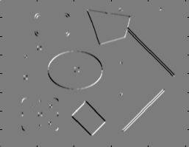
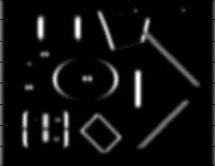
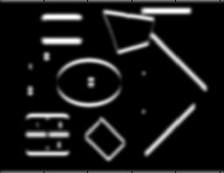
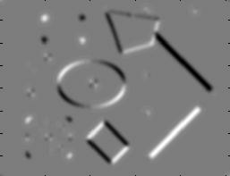
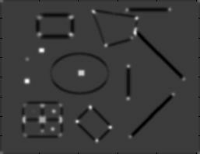
Harris Detector
Second moment matrix (autocorrelation matrix)
I_{x}
I_{y}
1. Image derivatives
I_{x}²
I_{y}²
I_{x}I_{y}
2. Square of derivatives
3. Gaussian filter g(σ_{I})
g(I_{x}²)
g(I_{y}²)
g(I_{x}I_{y})
4. Cornerness function – both eigenvalues are strong
5. Non-maxima suppression
har
Slide: Derek Hoiem

Slide 32

Harris Detector: Steps

Slide 33

Harris Detector: Steps
Compute corner response R

Slide 34

Harris Detector: Steps
Find points with large corner response: R>threshold

Slide 35
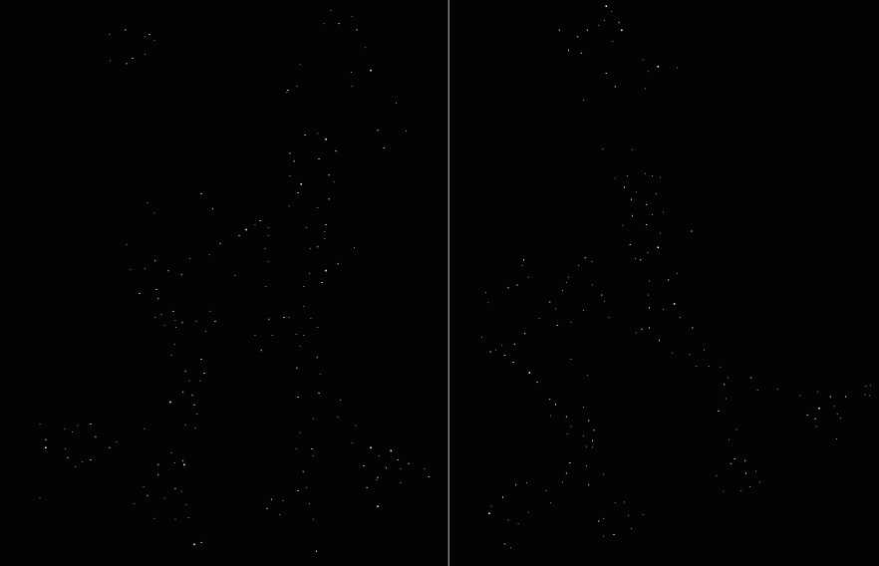
Harris Detector: Steps
Take only the points of local maxima of R

Slide 36

Harris Detector: Steps

Slide 37
Invariance and covariance
We want corner locations to be invariant to photometric transformations and covariant to geometric transformations
Invariance: image is transformed and corner locations do not change
Covariance: if we have two transformed versions of the same image, features should be detected in corresponding locations

Slide 38
Affine intensity change
I → a I + b
Only derivatives are used => invariance to intensity shift I → I + b
Intensity scaling: I → a I
R
R
threshold
x (image coordinate)
x (image coordinate)
Partially invariant to affine intensity change

Slide 39
Image translation
Derivatives and window function are shift-invariant
Corner location is covariant w.r.t. translation

Slide 40
Image rotation
Second moment ellipse rotates but its shape (i.e. eigenvalues) remains the same
Corner location is covariant w.r.t. rotation

Slide 41
Scaling
Corner
All points will be classified as edges
Corner location is not covariant to scaling!

Slide 42
Local features: main components
Detection: Identify the interest points
Description:Extract vector feature descriptor surrounding each interest point.
Matching: Determine correspondence between descriptors in two views

Slide 43
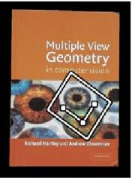



Geometric transformations
e.g. scale, translation, rotation

Slide 44
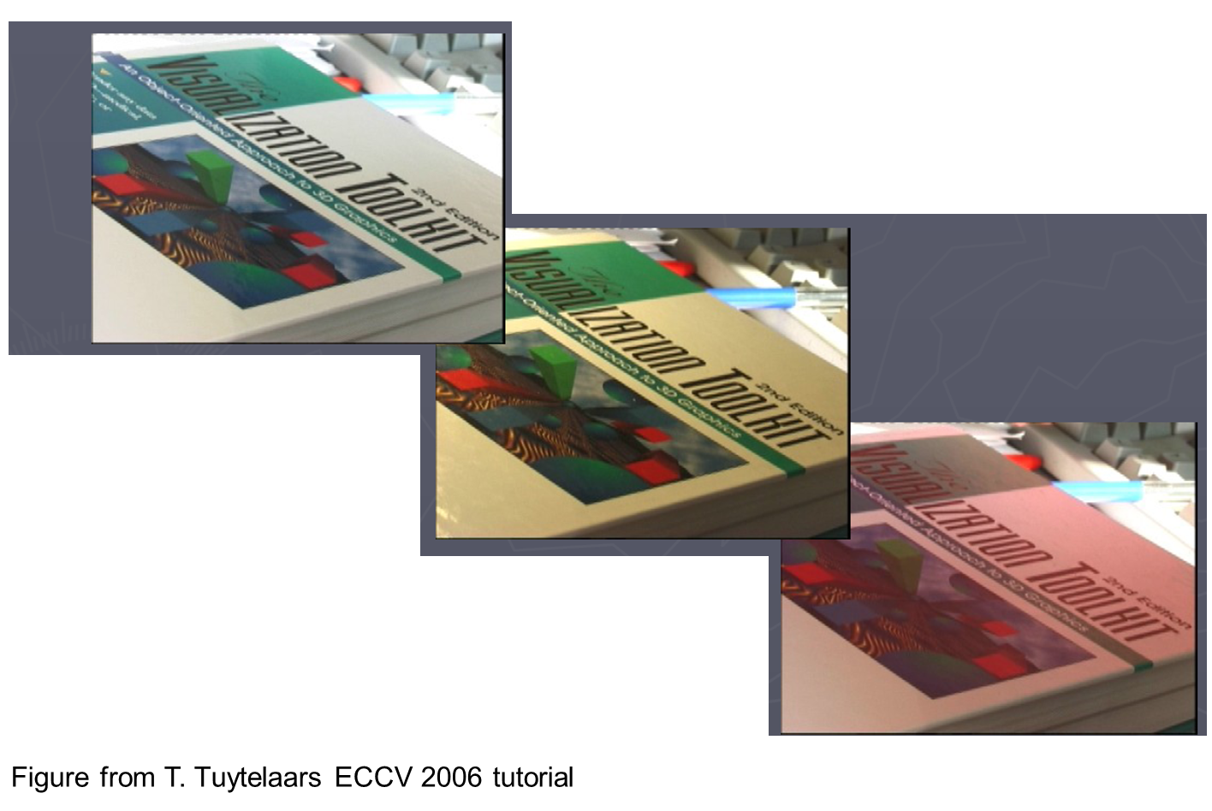
Photometric transformations

Slide 45
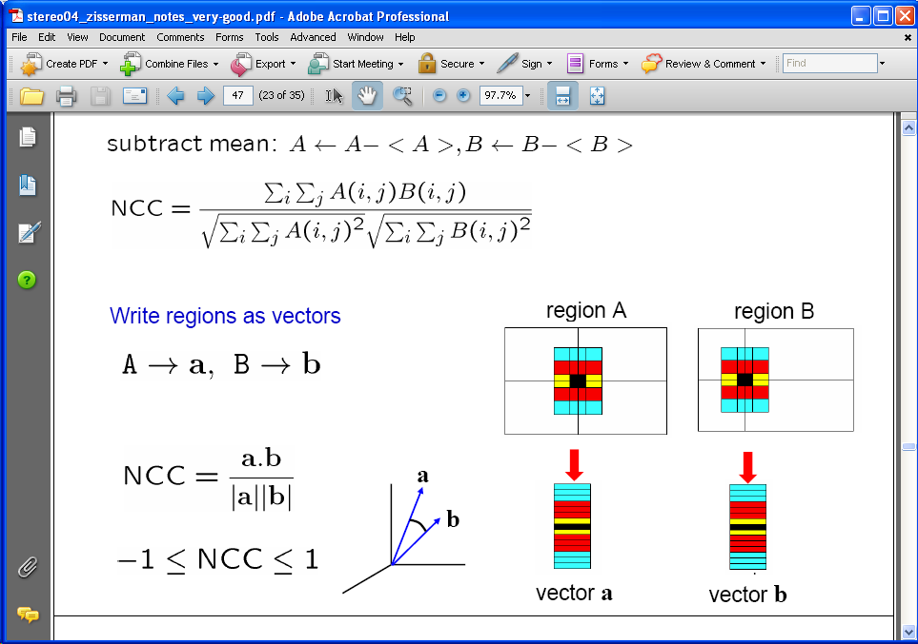
Raw patches as local descriptors
The simplest way to describe the neighborhood around an interest point is to write down the list of intensities to form a feature vector.
But this is very sensitive to even small shifts, rotations.

Slide 46
Thank you
Next Lecture: Feature descriptor and matching

